Slide 1

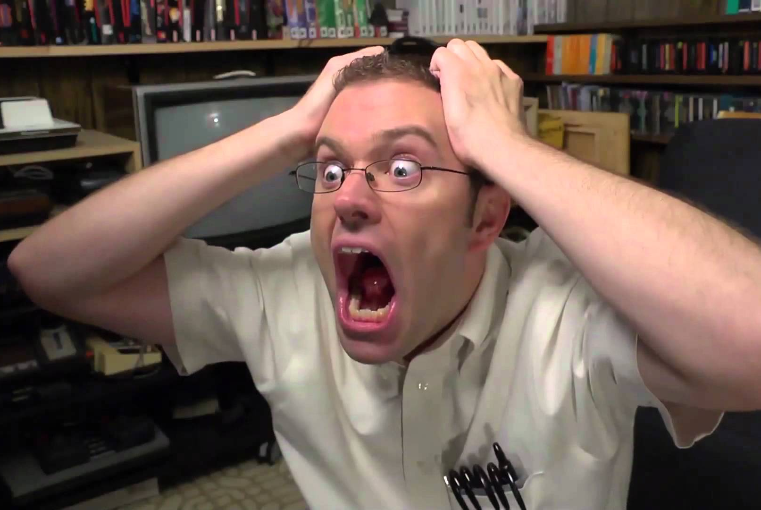
Good vs. Bad Difficulty in Games – What Makes Challenge Fun?

Slide 2
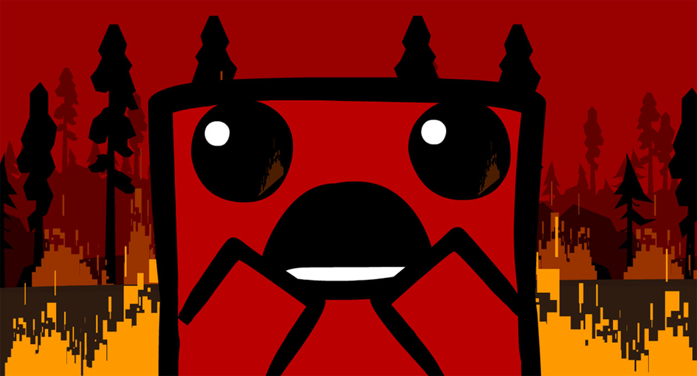
Why do we like challenge?
Feeling of reward/accomplishment
Lack of difficulty can be boring
Test our skills, acquire new skills
Some of us just like to tear our hair out ☺

Slide 3
What makes a fair challenge?
Player is always in control
The difficulty isn’t distracting
Minimal “cheap” lose conditions
Lose condition is directly the player’s fault
It’s clear why the player failed
Player will learn something from failing or overcoming that challenge

Slide 4
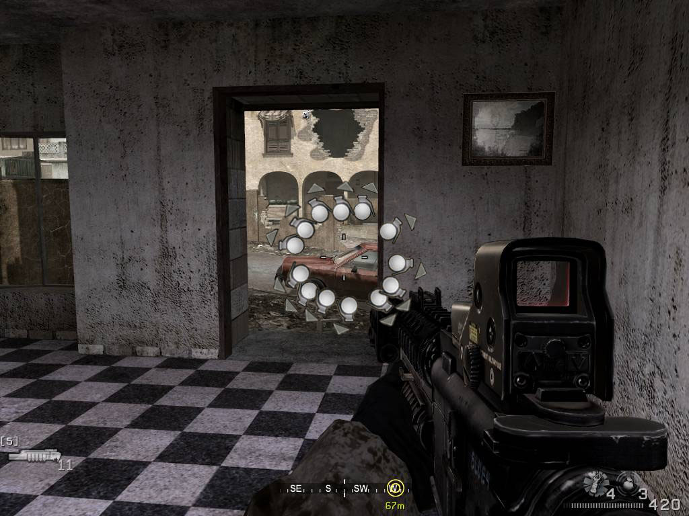
What is bad difficulty?
Mastery of game is taken out of player’s hands
Overcoming challenges requires exploits
Player is constantly put in unfair situations
Difficulty through randomness (i.e. luck-based challenge)
The player learns nothing through overcoming challenges

Slide 5

GOOD Difficulty

Slide 6
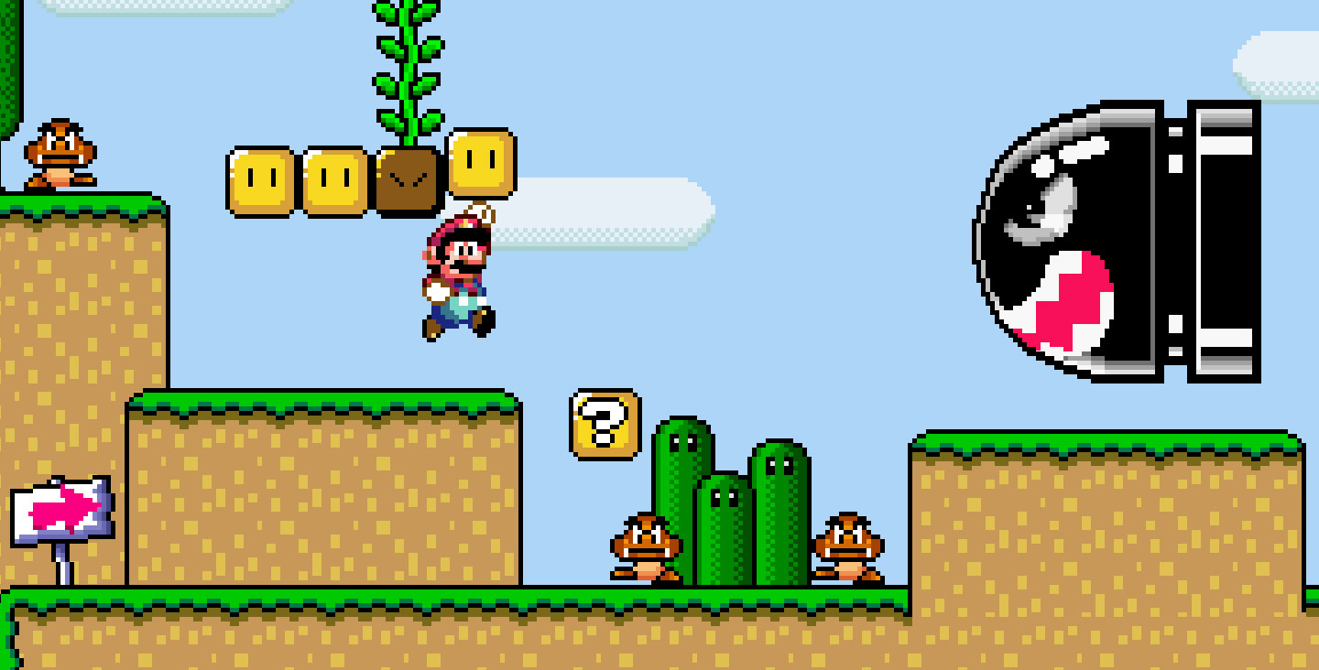
Examples of Good Difficulty
Super Mario Bros 3/World – Level design
Pokemon Black2/White2 – Hard Mode
The Binding of Isaac: Afterbirth – The Lost (hear me out)
Fire Emblem Fates: Birthright/Conquest – Map design and balance
Age of Mythology – Hard mode campaign

Slide 7
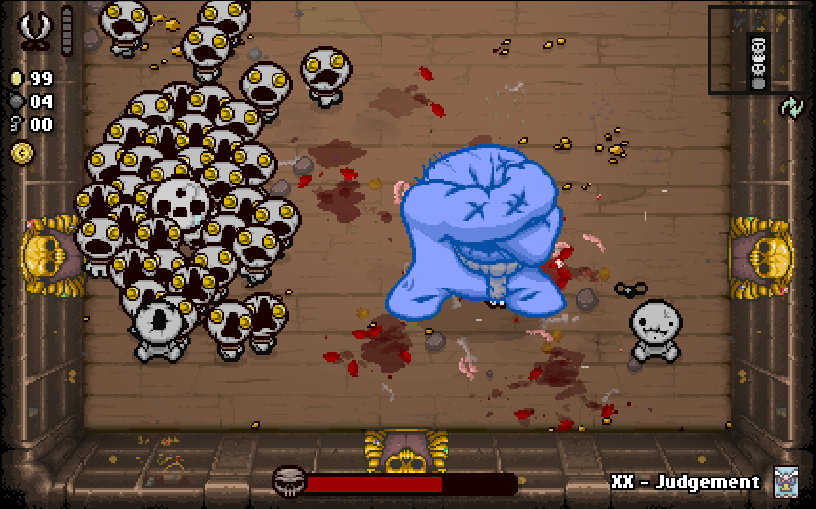
The Binding of Isaac: Rebirth – The Lost

Slide 8
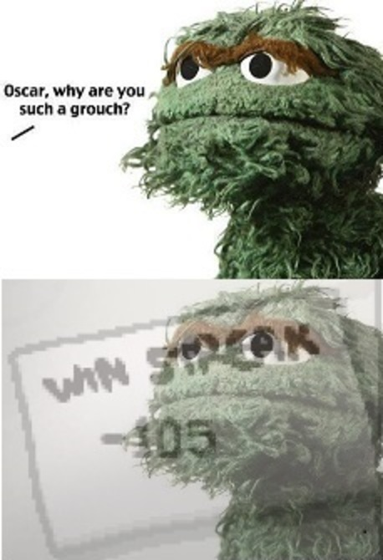
The Binding of Isaac: Rebirth – The Lost
Before: (aka pre-Afterbirth DLC)
1 hit kill (no HP)
Starting items: 1 coin
Start with flight
Free devil rooms
Demanded perfect play and RNG
Not very fun

Slide 9
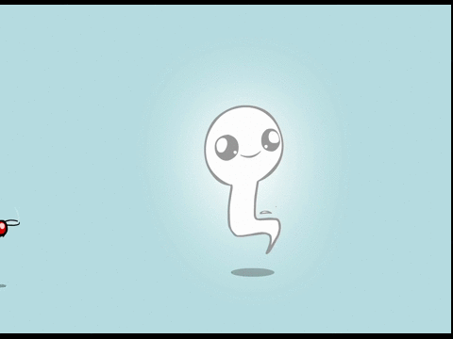
The Binding of Isaac: Rebirth – The Lost
Afterbirth expansion buffs The Lost
Lost now starts with:
Ability to re-roll collected items
Shoot through obstacles
Unlockable shield: 1 free hit per room
Much more playable!
Actually my favorite character
Super fun to get broken as him

Slide 10
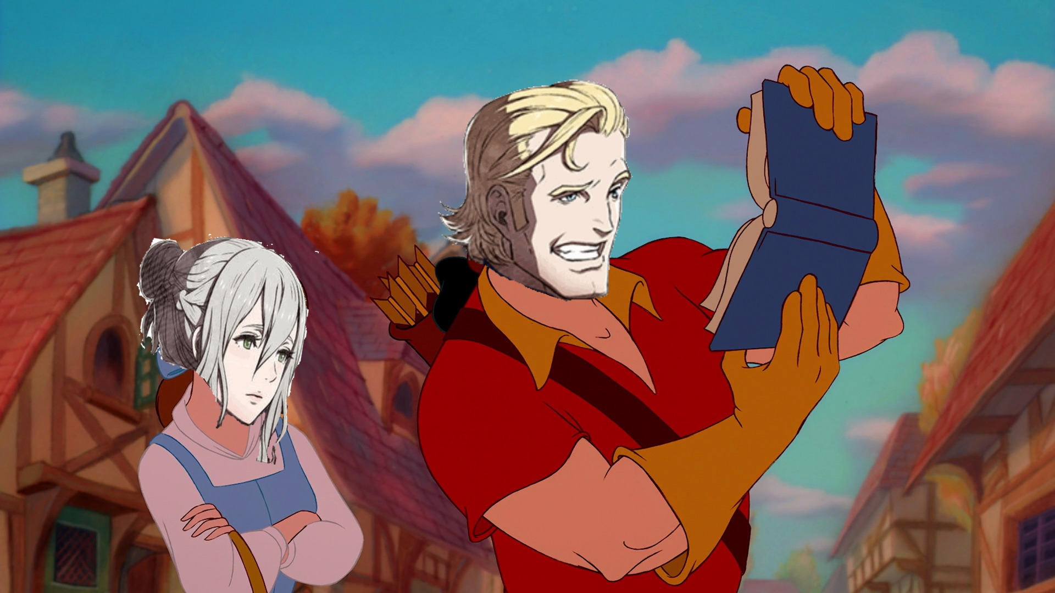
Fire Emblem Fates – Balance & Map Design

Slide 11
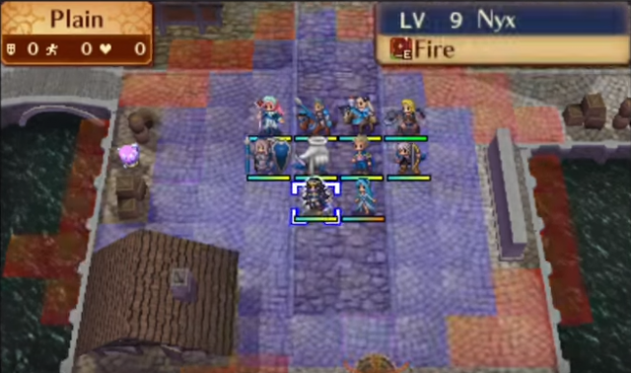
Fire Emblem Fates – Balance & Map Design
Disclaimer: I’m still a Normal mode scrub
Near-flawless difficulty curve, enemy scaling, balance
HUGE step up from Awakening
Never had a cheap death yet
Conquest Ch 10
Every unit has a role
Can’t just wing it, but not unfair
Always a way to turn a situation in your favor

Slide 12
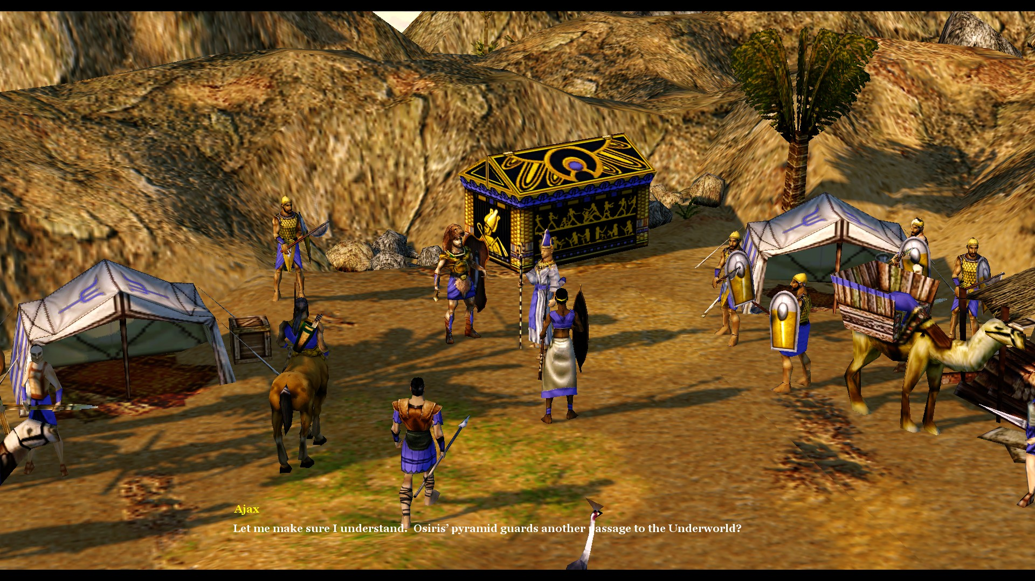
Age of Mythology – Hard Mode Campaign

Slide 13
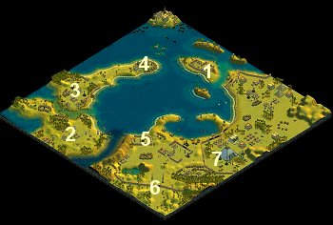
Age of Mythology – Hard Mode Campaign
One of my favorite single-player campaigns of all time
Good difficulty scaling
4 difficulties, 3 distinct tiers
E.g. Mission 15
Easy: Enemies have fewer defensive units/upgrades, Player gets more units/resources/technologies. Allies start with more stuff.
Hard: Enemies have more starting units/upgrades/defenses. Player gets fewer starting resources, no defensive buildings.
Titan: Even fewer starting resources and buildings for player.

Slide 14

BAD Difficulty
Note: I won’t actually be talking about Fates here but I figured Peri’s angry face is perfect for this. Plus I just wanted an excuse to include her and her awesome hair :p

Slide 15
Disclaimer: Bad difficulty =/= bad game!

Slide 16
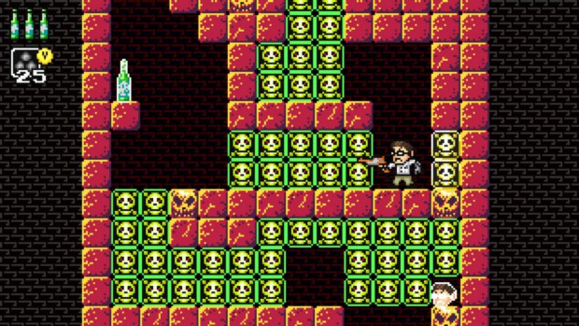
Examples of Bad Difficulty (and why they’re bad)
Skyrim (and many others) – “damage slider” difficulty
Call of Duty (Veteran mode) – It’s raining grenades
Angry Video Game Nerd Adventures – Every block is insta-kill (I wish I were joking)
The Binding of Isaac: Afterbirth – LOTS of things
Fire Emblem Awakening – Lunatic+ Mode
Borderlands 2 – Level scaling
Civilization 5 – Deity Mode

Slide 17
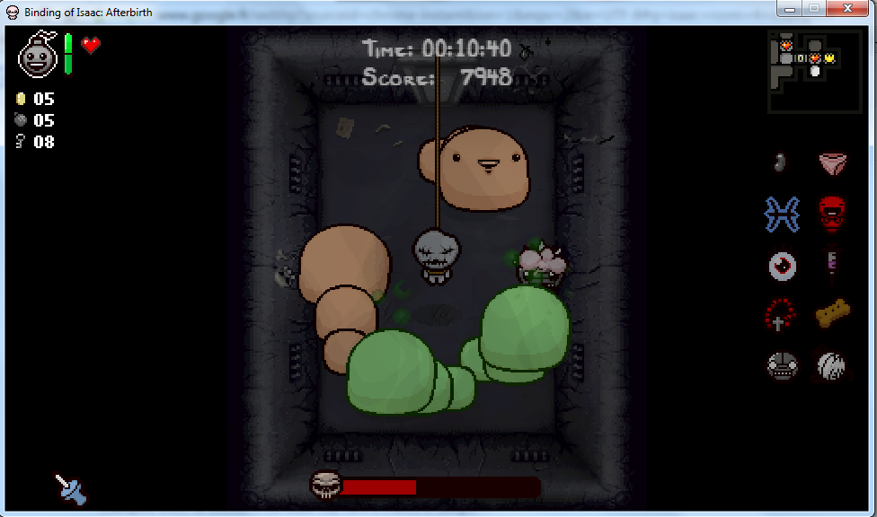
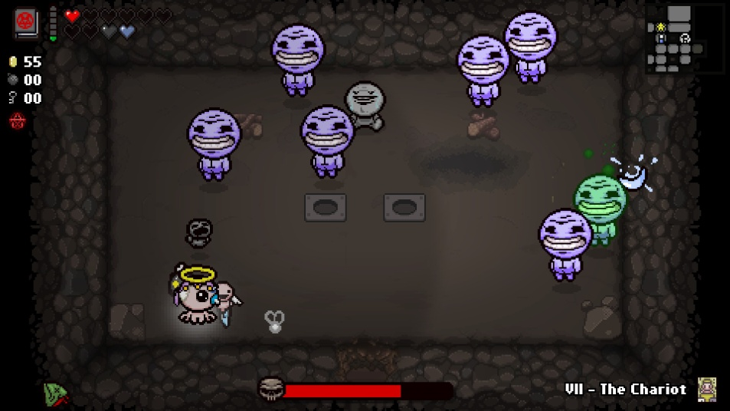
The Binding of Isaac: Afterbirth
LOTS of things
Make sure Connor doesn’t rant about the devs
Here we go:
Tons of unavoidable damage
Out-of-place difficulty spikes
Small rooms
New Krampus
Secret boss health scaling
Getting Mega Stan is purely RNG based
The Keeper – when gimmicks go too far

Slide 18
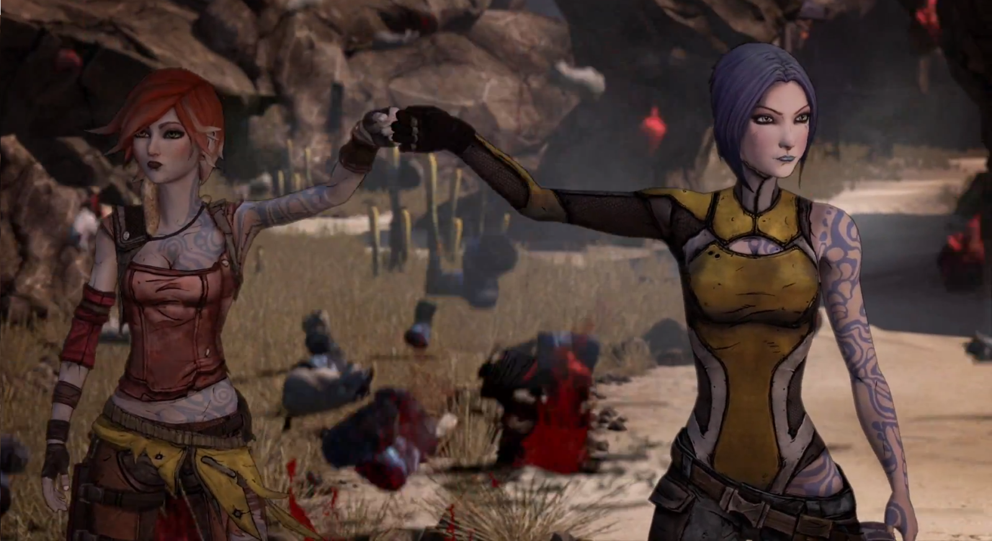
Borderlands 2 – Level Scaling & Late Game

Slide 19
Borderlands 2 – Level Scaling & Late Game
Borderlands 1 – Linear level curve
Borderlands 2/Pre-Sequel – Exponential Curve
Effects become apparent ~halfway through Playthrough 2
Playthrough 3 – Enemies get 4x health, gain health regen
Slag effect (damage bonus) buffed, weapon swap speed up
Still not solo-friendly, casual-friendly
Weapons eventually become obsolete after every level
Often requires optimal builds
Dominant strategy issue

Slide 20
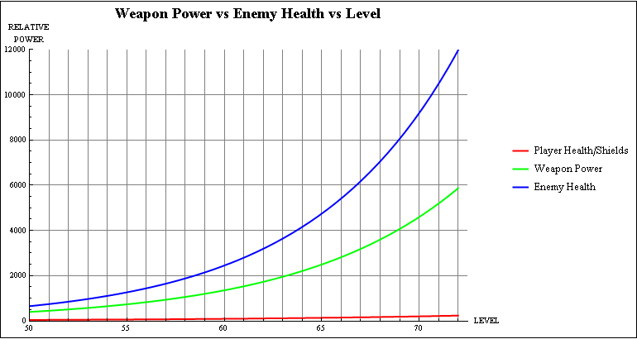
Borderlands 2 – Level Scaling & Late Game

Slide 21
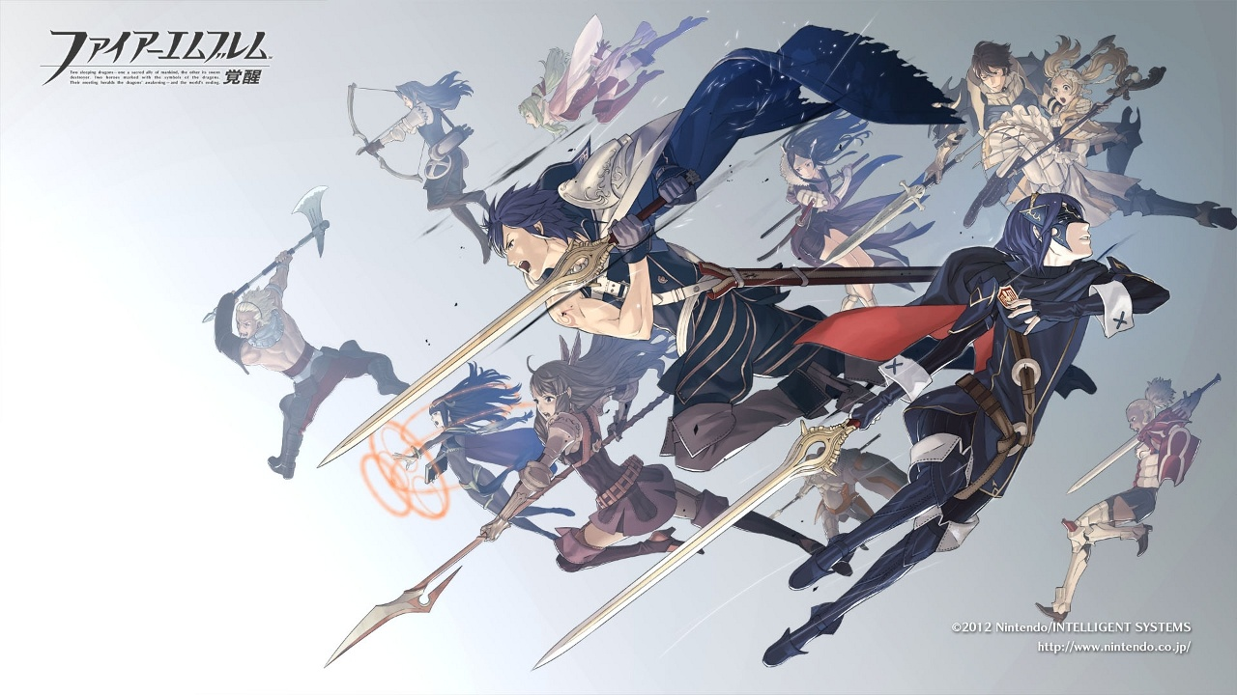
Fire Emblem Awakening: Lunatic+

Slide 22
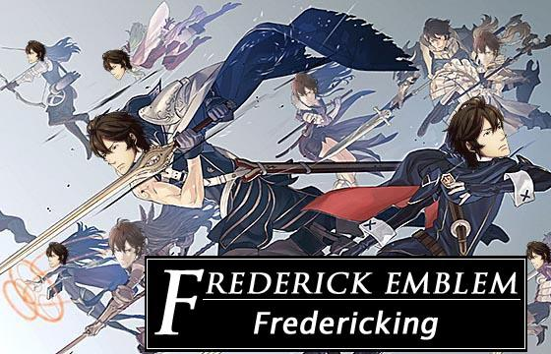
Fire Emblem Awakening: Lunatic+
AKA Frederick Emblem

Slide 23
Fire Emblem Awakening: Lunatic+
Lunatic-level stats
PLUS, 2 skills randomly chosen on EACH foe:
Reflect physical damage
100% Hit rate (lolRNG)
Pass through your units
Half bow/magic/dragonstone damage
Half sword/axe/lance/beastone damage
Always cut target defense/resistance by half
Always attack first (lolPlayerPhase)
Common “strategy”: reset to generate the fewest OP foes

Slide 24
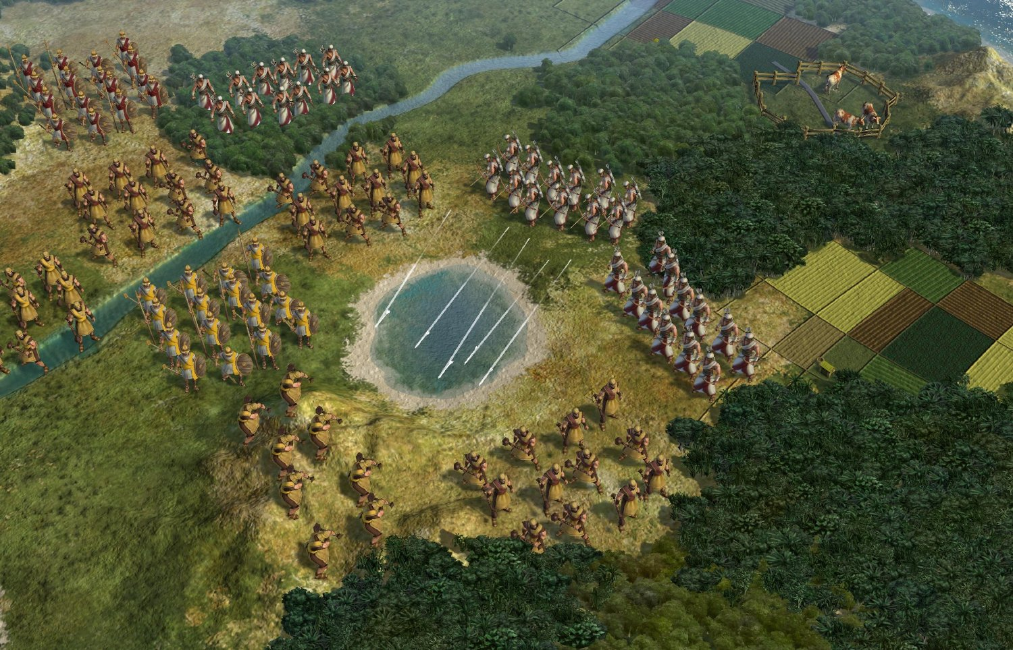
Civilization 5: Deity Mode

Slide 25
Civilization 5: Deity Mode
Game AI is hard
Especially for strategy games
“Best” way to create harder AI: cheating/unfair advantages
Biggest difference: AI starting units, techs
Player strategy is built around exploiting AI at this point
 | Settlers | Workers | Military | Techs
Immortal (2nd hardest) | 0 | 1 | 2 | Pottery, Husbandry, Mining, Archery
Deity (hardest) | 1 | 2 | 2 | All Immortal techs + Wheel

Slide 26

But not everything’s so black and white
I’ll show myself out…

Slide 27
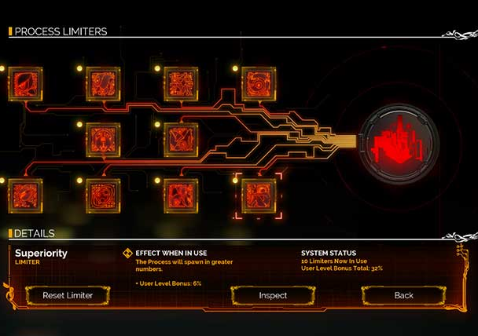
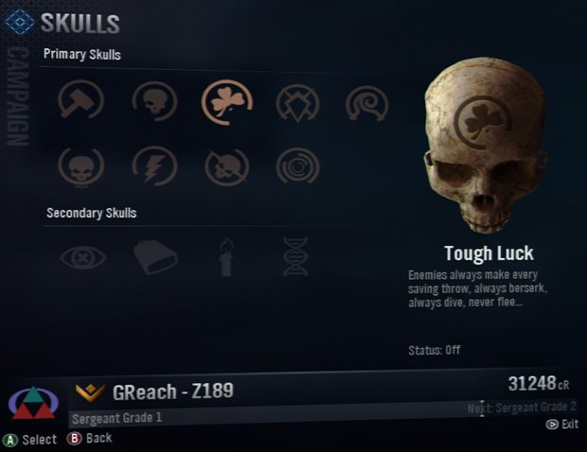
Other Areas in Good/Bad Difficulty
Player-crafted difficulty (Bastion, Transistor, Halo)
Narrative-based difficulty (Undertale)
“No” difficulty aka “Click through the story”

Slide 28

Undertale (Genocide Run)
That ONE boss
Most people quit at this point for one reason for another
This boss was designed to make players quit.
That’s not something you see often.
Gameplay perspective – not that fun.
Narrative perspective – perfect!

Slide 29
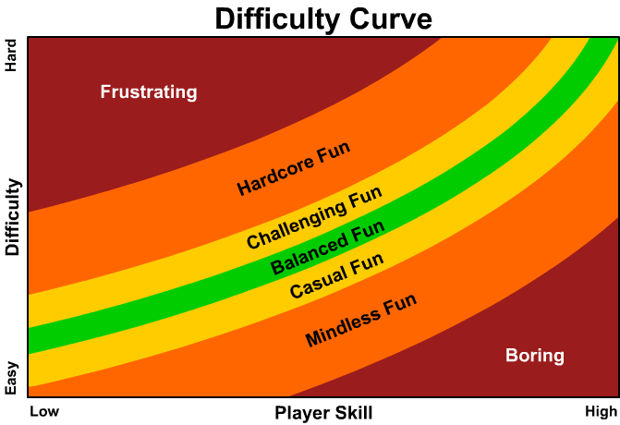
Takeaways
Rewarding difficulty: much easier said than done
Different people like different difficulties
Difficulty for difficulty’s sake: not always so good
Challenge should be rewarding, not tedious/frustrating
Making good difficulty isn’t easy!

Slide 30

THANKS FOR LISTENING!
Questions? Comments? Angry banter?

Slide 31
Further Reading
Ed McMillen on “Meaningful Difficulty [in The Binding of Isaac: Afterbirth],” written in response to community backlash after extensive (and in many cases unwanted/unwarranted) balance changes were made following the DLC’s release: https://www.reddit.com/r/bindingofisaac/comments/3ryzof/re_meaningful_difficulty/
Discussion on /r/truegaming about how Civ 5 handles “stronger” AI poorly: https://www.reddit.com/r/truegaming/comments/1oo9y3/i_completely_hate_how_the_difficulty_increases_in/
Distinguishing good from fake difficulty: https://www.reddit.com/r/truegaming/comments/17e7uu/how_do_you_distinguish_good_difficulty_from_bad/
Josh Sawyer (designer/writer- Fallout: New Vegas) on balancing a single-player RPG: http://kotaku.com/how-to-balance-an-rpg-1625516832

